Slide 1
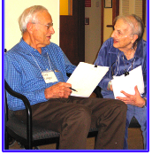
BRING CONNECTION AND RELATIONSHIPS TO ANYONE WITH CIRCLETALK™

