Slide 1
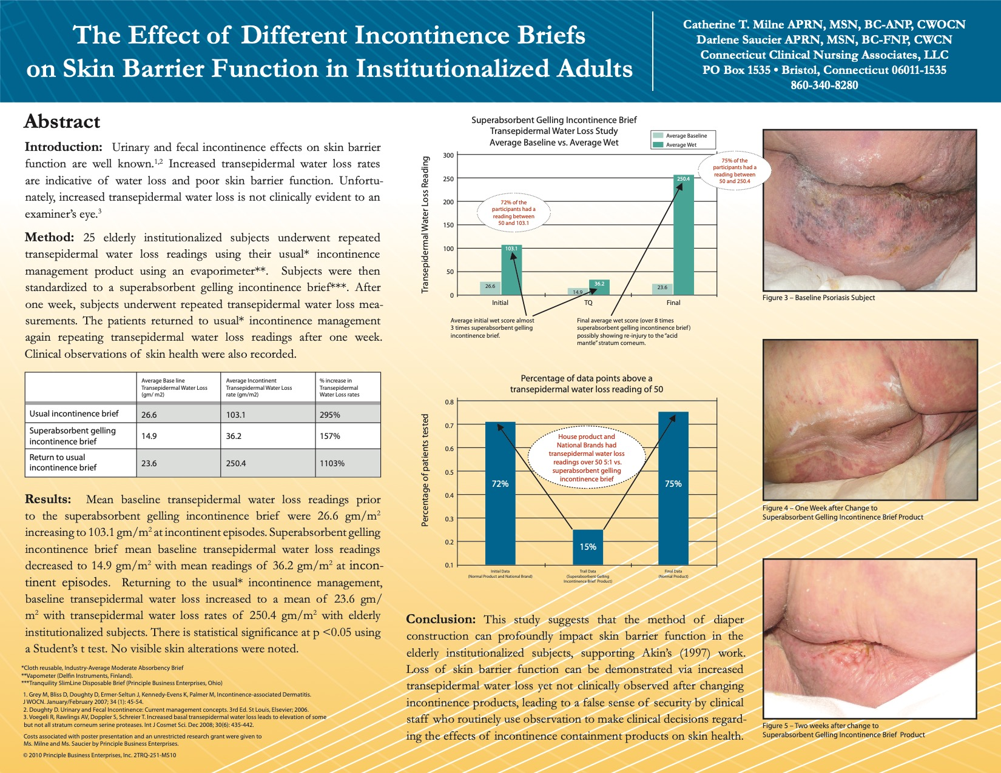
Dryer skin
Reduced effects caused by urinary incontinence
Less skin maceration, infection, pressure injuries and other costly consequences.

Slide 2
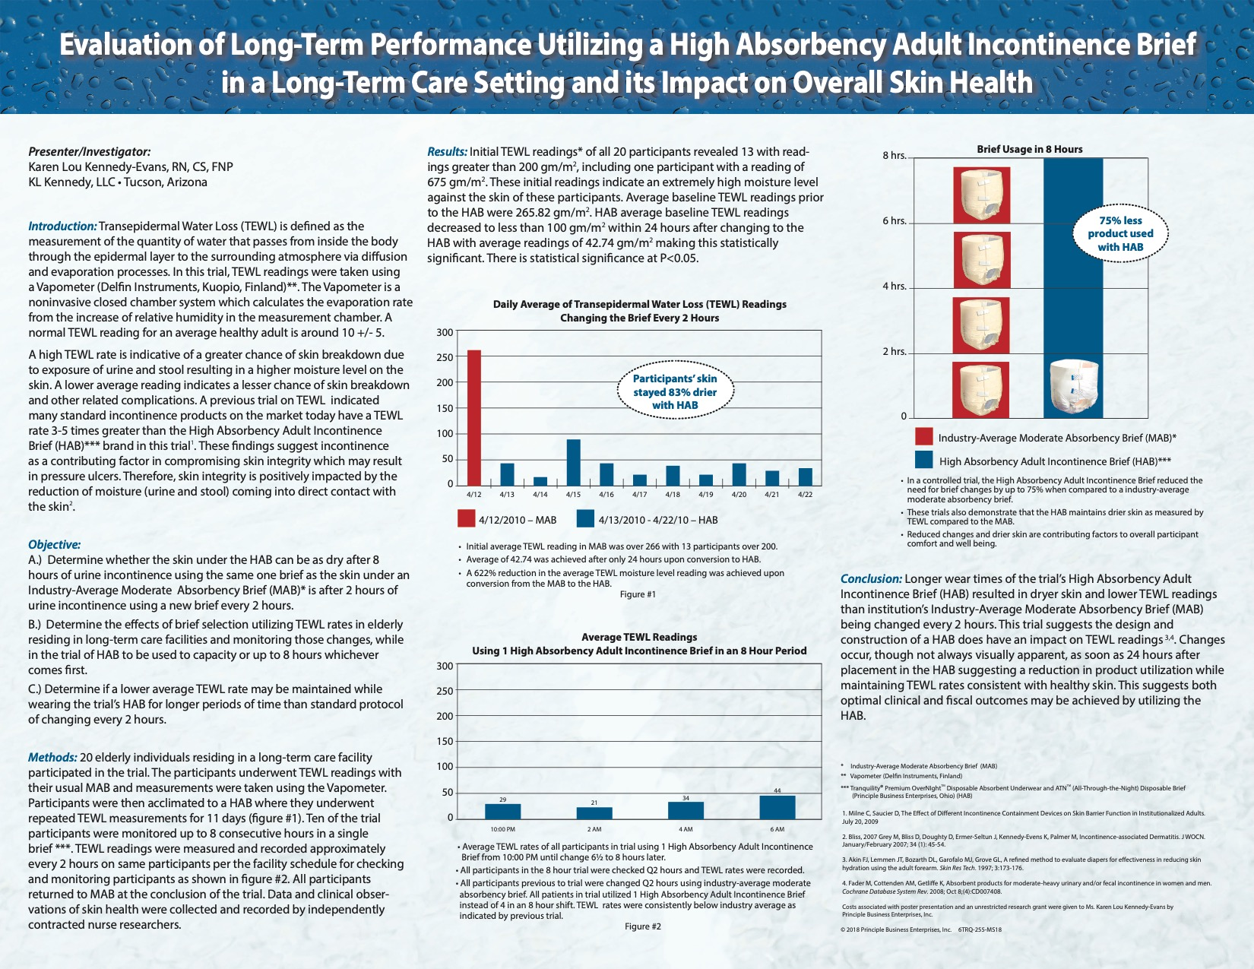
Optimal clinical and fiscal outcomes
Longer wear times
Less changes
Dryer skin
Less interruptions (especially through the night)

Slide 3
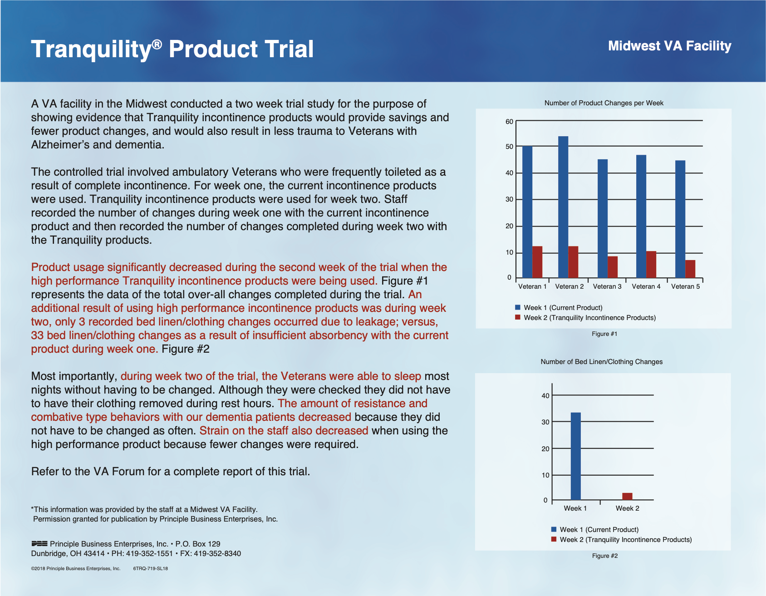
Veteran’s sleeping better most nights
Less resistance and combative behavior with dementia patients
Less changes

Slide 4
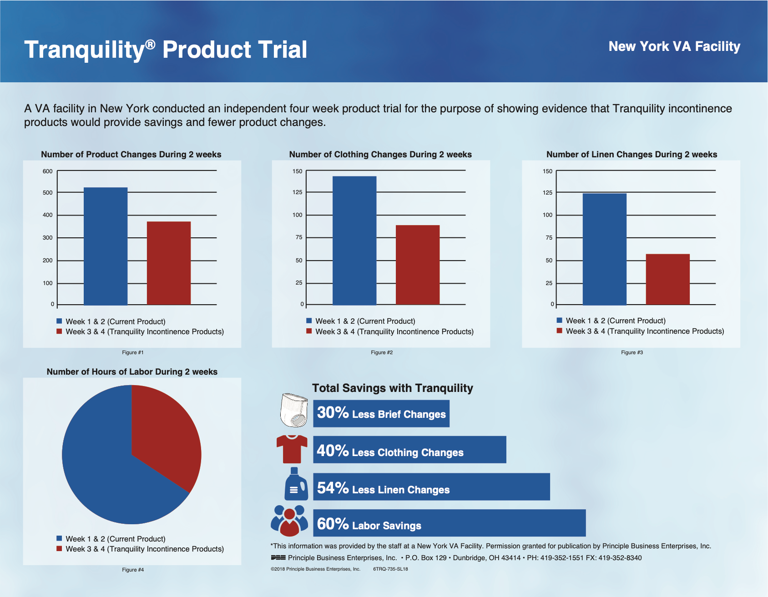
Less is Best…
Less brief changes
Less clothing changes
Less linen changes
Less labor

Slide 5
Less Usage
Better Outcomes
Significant Skin Improvement

